Slide 1
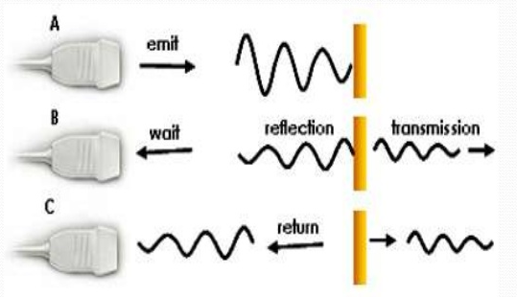
Principles of ultrasound
Ultrasound fundamentals
Acoustic properties of tissue
Pulse echo procedure
Principles and properties of ultrasound waves
Transducers
18.6.6 Principles of ultrasound
Unit C18.6 Maintaining Medical Imaging Equipment
Module 279 19 C Medical Instrumentation II
©
dr. Chris R. Mol, BME, NORTEC, 2016

Slide 2
Sound & ultrasound waves
(Ultra-)sound is a longitudinal wave in a material. The frequency of the ultrasound waves used in medical imaging is in the 2-18 MHz range, well above the highest frequencies that humans can hear (20kHz).
longitudinal wave in a spring: the frequency depends on how fast the hand is moved.
wave length
an (ultra-)sound wave is a series of compressions and rarefactions propagating in a medium.
wave length = sound velocity in the medium / sound frequency.
the wavelength of a 1.5 MHz ultrasound wave in tissue (1500 m/s) = 1 mm.
©
Ultrasound Principles
dr. Chris R. Mol, BME, NORTEC, 2016

Slide 3
Acoustic properties of tissue: ultrasound velocity
How fast the ultrasound wave is propagated through a material depends on the type of material, especially its density. For example:
in air 330 m/s
in water 1,480 m/s
in muscle 1,580 m/s
in bone 4,080 m/s
in steel 6,000 m/s
‘Soft tissues’, such as muscles, kidneys, liver and heart have quite similar ultrasound velocities around 1,500 m/s.
Bone and air (in the lungs), as well as metal implants, are more compact and have quite different acoustic properties.
Ultrasound gel is used to make sure that there are no air bubbles between transducer and patient. Air bubbles would reflect all ultrasound before it enters the patient.
©
Ultrasound Principles
dr. Chris R. Mol, BME, NORTEC, 2016

Slide 4
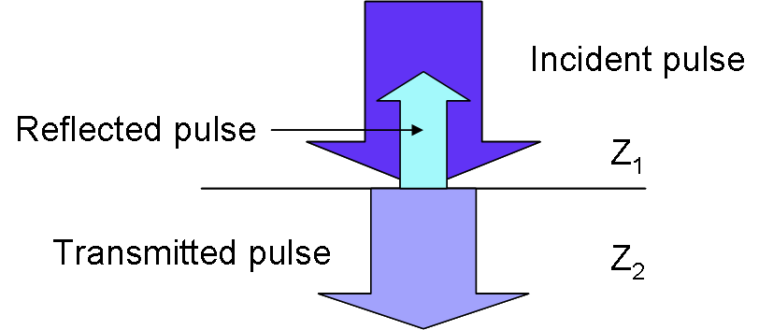
Properties of ultrasound waves
When (ultra-)sound travels through one type of tissue and hits another type of tissue, part of the wave (energy) will be reflected and part will be transmitted. The amount that is reflected (the ‘strength of the echo’) is dependent on how different the ultrasound velocities in the two types of tissue are.
The ultrasound that is reflected is used to create the ultrasound image.
For example:
if coming from muscle tissue, the wave hits a bone or air (in the lungs) most sound energy will be reflected and little is transmitted. Bone and air have very different acoustic properties from ‘soft tissue’ such as muscle.
If coming from fluid in the placenta, the wave hits fetal tissue, only a small part will be reflected and most will be transmitted. Most soft tissues have similar acoustic properties.
Ultrasound is mostly used for imaging ‘soft tissues’
©
Ultrasound Principles
dr. Chris R. Mol, BME, NORTEC, 2016

Slide 5
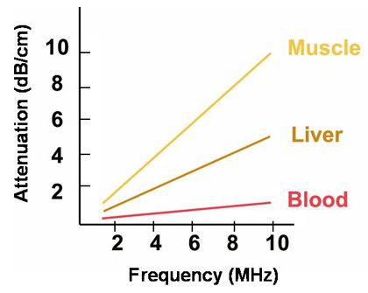
Acoustic properties of tissue: absorption of ultrasound
Some materials (tissues) absorb ultrasound waves more than others. For example, blood absorbs only a little, air absorbs a lot.
High ultrasound frequencies are absorbed more than low frequencies.
Lower sound frequencies lead to lower image resolution but greater tissue penetration.
Higher sound frequencies improve image resolution (finer detail) when deep penetration is not necessary.
Which ultrasound frequency to use (in the 2-18 MHz range) is therefore a trade-off between depth penetration and image resolution.
For clinical applications that require deep penetration a lower ultrasound frequency needs to be used.
©
Ultrasound Principles
dr. Chris R. Mol, BME, NORTEC, 2016

Slide 6
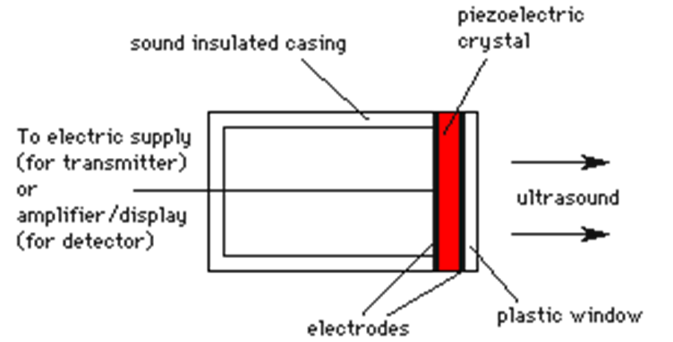
Transducers to create ultrasound waves
Ultrasound can be created by an ultrasound transducer which contains a piezo-electric crystal. When a strong, short electric shock is applied to such a transducer, the piezo-electric crystal will start to resonate and send out shock waves (ultrasound).
The frequency of the waves depends on the thickness of the crystal.
A piezo-electric crystal creates in principle one ultrasound frequency (band). This is why different transducers are needed for different applications.
However, sophisticated ‘multi-frequency’ or ‘broadband’ transducers contain multiple crystals and can produce different ultrasound frequencies. In this case the same transducer can be used for different clinical studies, but the system has to be switched over (button) to the frequency that is to be used for the study at hand.
©
Ultrasound Principles
dr. Chris R. Mol, BME, NORTEC, 2016

Slide 7
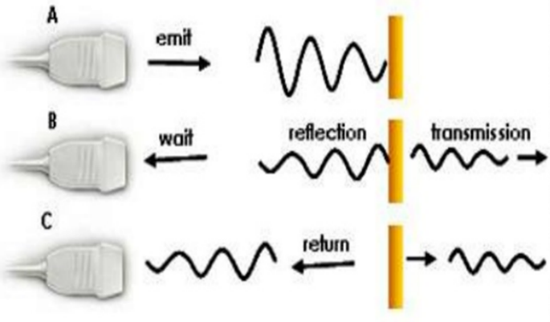
Pulse echo procedure: principle
The most common ultrasound technique uses the pulse echo method:
a short ultrasound pulse is transmitted by the transducer.
the transducer is then switched to ‘receiving mode’ and collects the ultrasound pulses (‘echoes’) that are reflected back towards the transducer, bouncing off from the different tissue transitions that the wave has encountered.
the time between transmission and receiving the echoes depends on the ‘depth’ of the reflecting layer: the longer it takes for an echo to return, the further away from the transducer was the reflecting layer.
the strength of an echo is a determined by the difference in tissue properties of the different tissue layers.
©
Ultrasound Principles
dr. Chris R. Mol, BME, NORTEC, 2016

Slide 8
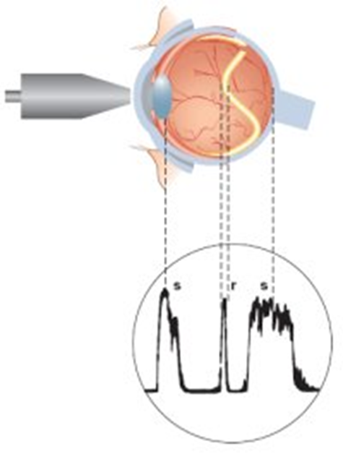
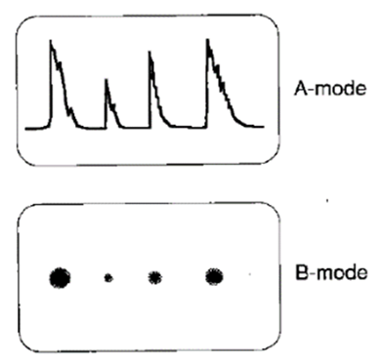
Pulse echo procedure: A, B display mode
retina
In this example, the different layers in an eye reflect the ultrasound. The echo indicated with r, shows that the retina has come loose from the back of the eye. This echo is not present in healthy people.
ultrasound
transducer
A-mode stands for Amplitude mode. The strength of the echo can be translated into the brightness of an image dot. This gives the B-mode (for Brightness).
received echoes
the signal amplitude indicates the strength of the echo
One transducer pulse gives measurements along one line
©
Ultrasound Principles
dr. Chris R. Mol, BME, NORTEC, 2016

Slide 9
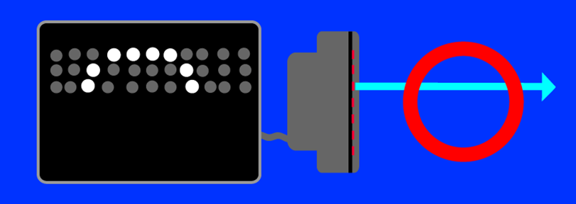
Pulse echo procedure: creation of an image
One ultrasound pulse gives measurements along one line only.
A two dimensional image is created by using a transducer which consists of a series of ultrasound crystals. Each transducer is used to acquire echoes along one line. All lines, side by side, create an image.
Ultrasound image
transducer with
multiple crystals
reflecting object
©
Ultrasound Principles
dr. Chris R. Mol, BME, NORTEC, 2016

Slide 10
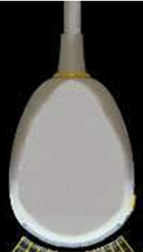
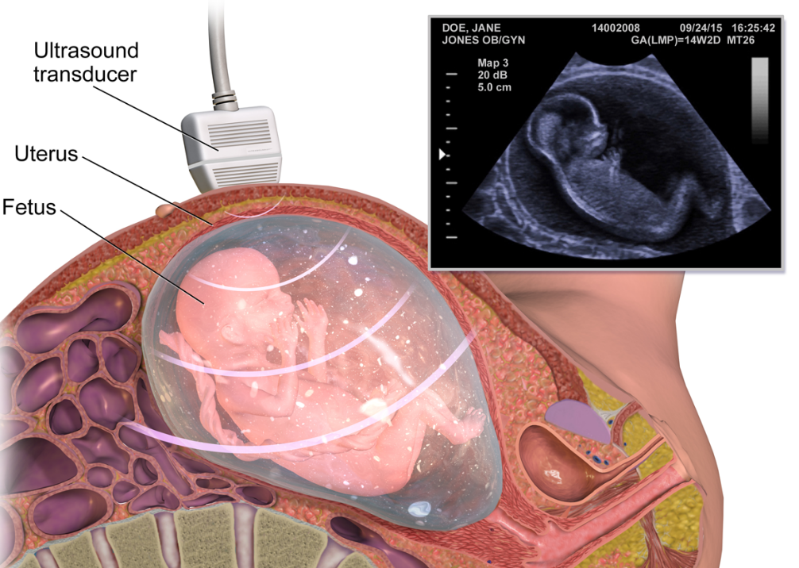
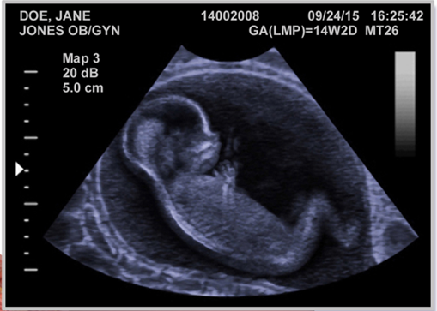
Pulse echo procedure: creation of an image
A full (B-mode) ultrasound image is built up from a large number of ultrasound pulses across the study object
©
Ultrasound Principles
dr. Chris R. Mol, BME, NORTEC, 2016

Slide 11
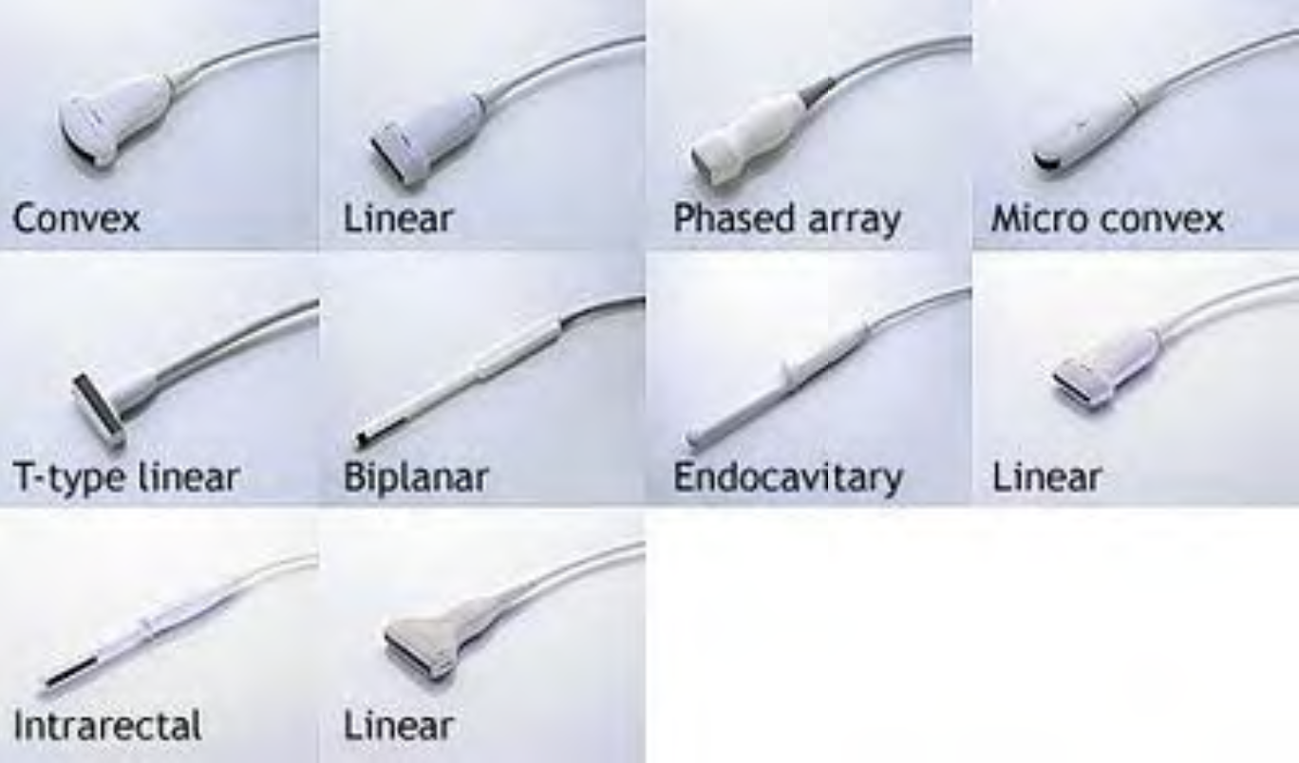
Ultrasound Transducers: shapes and sizes
There is a large variety of ultrasound transducers on the market. One reason for the different shapes is the application area. If the transducer needs to go inside a body cavity, the shape must be adapted to this. The other reason is the different technologies used in the transducer (next slides).
©
Ultrasound Principles
dr. Chris R. Mol, BME, NORTEC, 2016

Slide 12
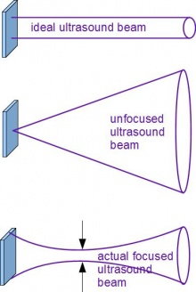
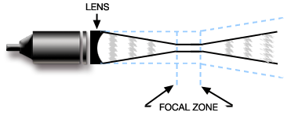
Ultrasound Transducers: focusing
The ultrasound beam from a simple crystal spreads out in the distance. This lowers the resolution of the image, since it cannot be determined precisely where an echo originates.
In order to avoid this, techniques to focus the ultrasound beam are applied. Older technology transducers focused their beam with a physical (plastic-like) lens in front of the transducer.
©
Ultrasound Principles
dr. Chris R. Mol, BME, NORTEC, 2016

Slide 13
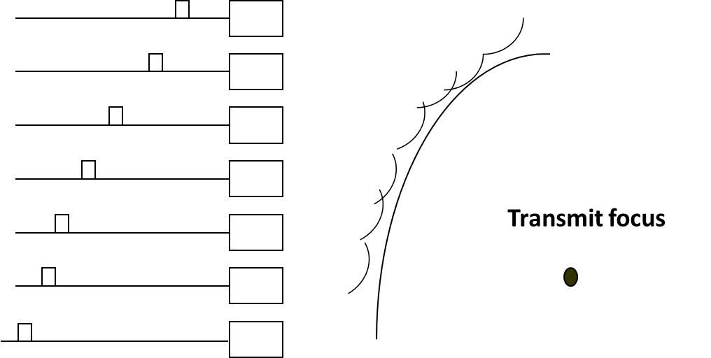
Ultrasound Transducers: focusing, beam forming
Newer technology transducers use phased array techniques to enable the ultrasound machine to change the direction and depth of focus.
This technique can be applied if the transducer contains many ultrasound crystals which can be controlled with a complex set of pulses from the system.
By having slight timing differences between pulses going to different crystals, desired ultrasound wave fields can be generated.
excitation
signals
ultrasound
beam
crystals
©
Ultrasound Principles
dr. Chris R. Mol, BME, NORTEC, 2016

Slide 14
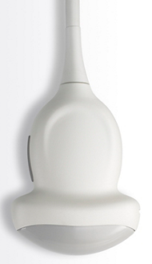
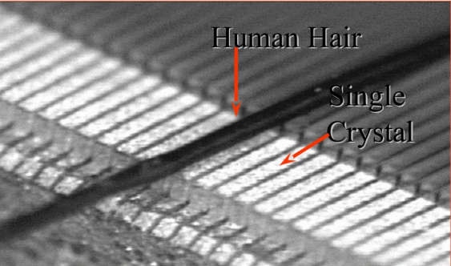
Different types of Ultrasound Transducers
crystals
Curved array
2D phased array
Linear array
Linear phased array
The transducer is an important part of an ultrasound system. Many variations of (piezo-electric) crystal configurations (‘arrays’) have been developed over time, all with specific (dis-)advantages.
Also the number of crystals (elements) in a transducer has increased enormously. Modern arrays can have many hundreds of elements (see microscopic picture).
©
Ultrasound Principles
dr. Chris R. Mol, BME, NORTEC, 2016

Slide 15
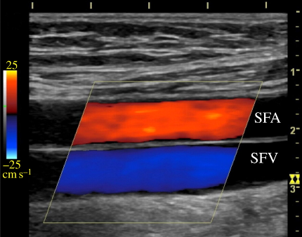
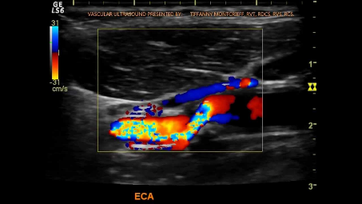
Color-flow Doppler Ultrasound
Ultrasound can be used to measure blood flow in arteries to assess blood flow abnormalities. This is accomplished by analysing the frequency shift in the ultrasound echoes. The change in frequency (compared to the transmitted pulse) is an indication for the speed of movement of the reflecting tissue: e.g. flowing blood. This speed is displayed as a colour.
Returned signal
Transducer
artery and vein on top of each other
Skin surface
Layers of intervening tissue
Blood flow
Vessel
Beam
blood vessel, turbulent flow
©
Ultrasound Principles
dr. Chris R. Mol, BME, NORTEC, 2016

Slide 16
END
The creation of this presentation was supported by a grant from THET:
see https://www.thet.org/

